Slide 1
Home Credit Risk Assessment
Xinying Shi
Yizhe Liu
Silu Zhao
Jiaming Hong
Group 5

Slide 2
How capable each applicant is of repaying a loan?

Slide 3
Project Statement in Details
Our task is to predict the "TARGET" variable for each id in the test set. We will measure the “TARGET” which shows whether clients with payment difficulties or not.
We will then conduct Linear Regression, Decision Tree Regression, Random Forest, and XGBoost on the training data to draw meaningful insights from the data through prediction and by calculating the MSE(Mean-Square Error), to evaluate the accuracy of the models.

Slide 4
Data Process

Slide 5
Approach
Data Cleaning
Data Imputing
One Hot Encoding
Find the model that gives us the least error.
Linear Regression
Decision
Tree
Clean
Data
Random
Forest
XGBoost
Notes:
Data cleaning the joint table -> insert into the train table which is the main table -> on hot -> clean the null value etc.

Slide 6
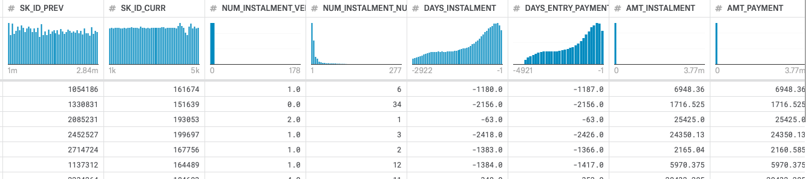
Join Table
There are several tables which have different features
Installments_payments.csv
DAYS_INSTALMENT - DAYS_ENTRY_PAYMENT -> Days Difference
AMT_INSTALMENT - AMT_PAYMENT -> AMT Difference
Combine the same Id in to one by calculating the mean value
Left Join to application_train.csv
Notes:
Days Difference: we can see whether the applicant pays the loan on time or not
ATM Difference: whether applicant pays the loan totally. Does they still own banks money after payment?
Since one applicant has more than one record, we do the mean to get the general situation whether they pay the money on time by calculating the mean of different value

Slide 7
Installments.csv
SK_ID_CURR | DAYS_INSTALMENT | DAYS_ENTRY | ATM_INSTALMENT | ATM_ENTRY
1 | -2156.0 | -2156.0 | 1716.525 | 1716.525
1 | -63.0 | -63.0 | 25425.0 | 25425.0
2 | -2418.0 | -2426.0 | 24350.13 | 24350.13
SK_ID_CURR | Diff_Day | Diff_ATM
1 | 0 | 0
1 | 0 | 0
2 | 9 | 0
SK_ID_CURR | Diff_Day | Diff_ATM
1 | 0 | 0
2 | 9 | 0
Notes:
Here is a simple demo

Slide 8
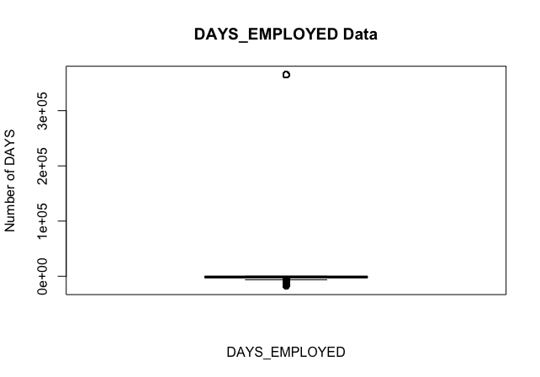
Clean Data Procedure -1
Anomalies Value
Boxplots for each features eg. DAYS_EMPLOYED Data

Slide 9
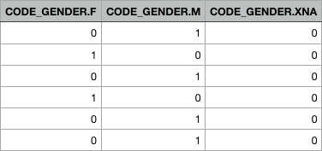
Clean Data Procedure -2
Keep the predictor which has <20% null value
Convert the categorical variables to their numerical
Using one-hot transformation
For Null value:
Using mean value
Notes:
For example, gender has F,M.XNA there different values. After one hot encoder, we get the gender as this table

Slide 10
Linear Regression

Slide 11
Linear Regression
Multiple linear regression is the most common form of linear regression analysis.
As a predictor analysis, the multiple linear regression attempts to model the relationship between two or more explanatory variables and a response variable by fitting a linear equation to observed data.

Slide 12
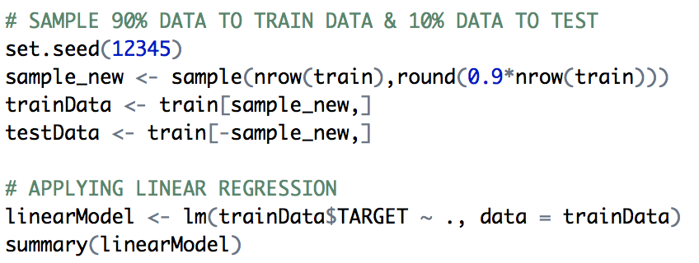
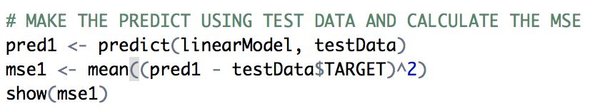

Procedure
Random select 90% of the data to train and other 10% to test, build the first linear regression model by taking all the columns.
Apply linear model on test data to predict the results.
Notes:
# P-value tests whether R-squared is different from 0.
# Usually we need a p-value lower than 0.05 to show a statistically significant relationship between X and Y.
# It indicates the reliability of X to predict Y.
# Performs an F-test on the model. This takes the parameters of our model and compares it to a model that has fewer parameters.
# In theory the model with more parameters should fit better.
# If the model with more parameters (your model) doesn't perform better than the model with fewer parameters,
# the F-test will have a high p-value.
# If the model with more parameters is better than the model with fewer parameters, you will have a lower p-value.

Slide 13
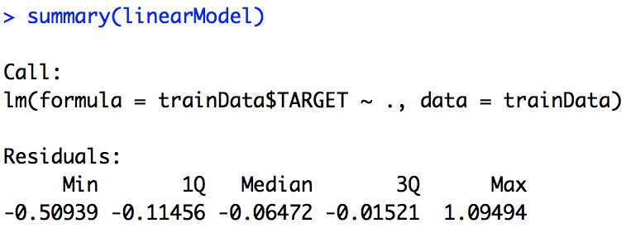
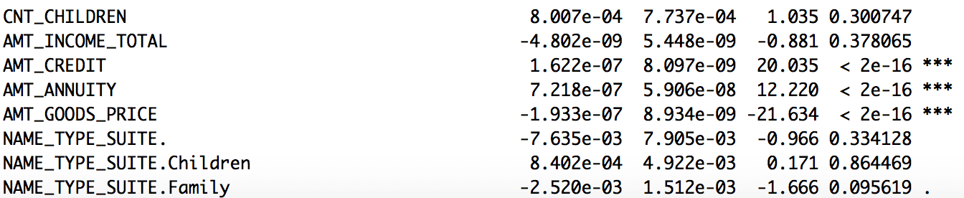
Procedure
Using p-values to reduce the dimension
Discarded the features which p-value >= 0.05 as insignificant variables and makeup a new dataset
Signif. codes: 0 ‘***’ 0.001 ‘**’ 0.01 ‘*’ 0.05 ‘.’ 0.1 ‘ ’ 1

Slide 14
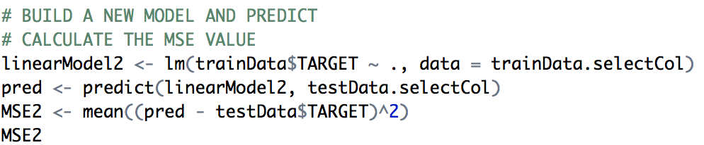

Procedure
Use only important features to build the new linear regression model and predict with new test data.
The result doesn’t show significant difference with the previous result.
Double check with PCA(MSE:0.06911)
Notes:
we also use the Principal component analysis to compare the accuracy to make sure we select the right important features by p-value

Slide 15
Decision Tree

Slide 16
Procedure
Take about 30% preprocessed data as my original data.
Divide the original data into two parts - training data and test data.
90%
10%
Notes:
A decision tree is a tool that uses a tree-like graph of decisions to classify data.

Slide 17
Procedure
Use rpart() to train the model on training data.
Minsplit: the minimum number of observations that must exist in a node
Minbucket: the minimum number of observations in any terminal node
Cp: the complexity parameter, set cp to a negative amount ensures that the tree will be fully grown
Maxdepth: depth of the tree, which can be used to prune our tree forcibly
Notes:
We used the rpart package to realize the Decision Tree Algorithm
Following is the specific method that I have passed several parameters in
Because some default parameters may prevent our tree from growing.
Lets focus on Maxdepth, … .
So by fixing the Maxdepth, we can find optimal model for both training data and test data.

Slide 18
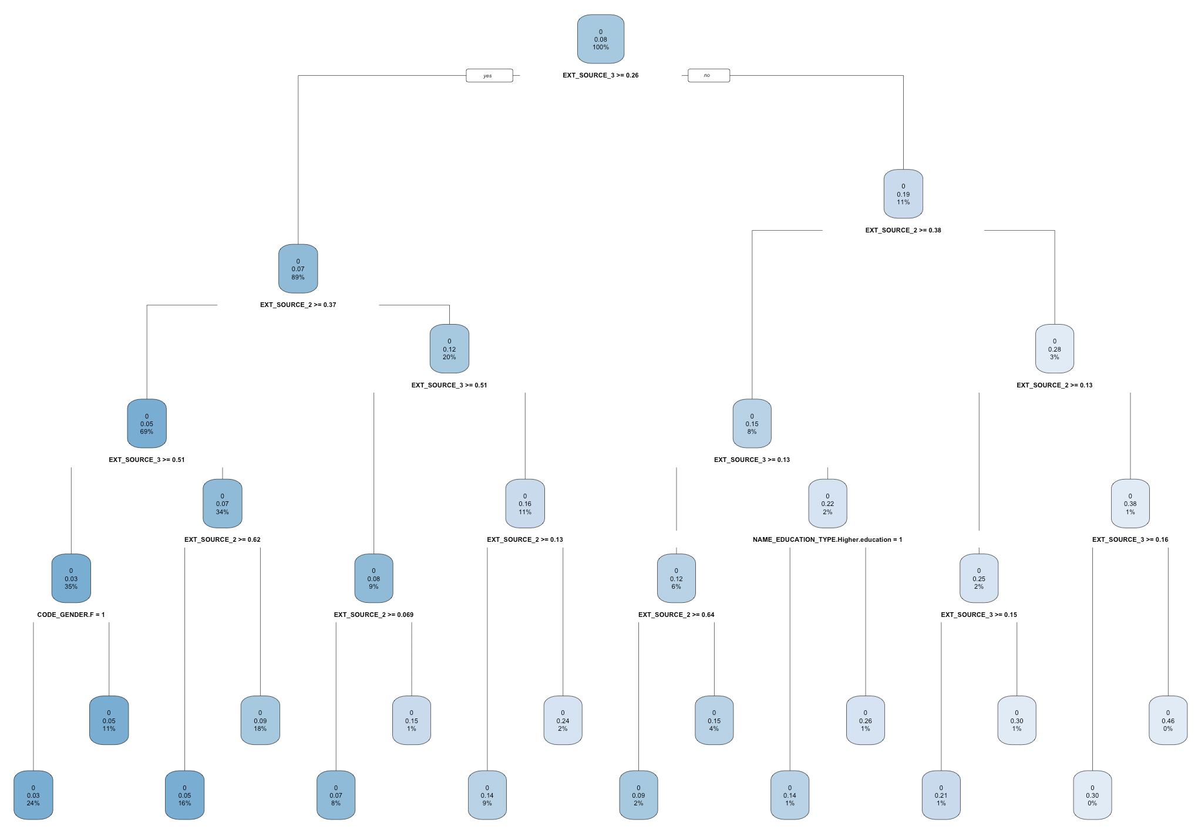
Maxdepth=5
Notes:
And this is the plot when Maxdepth equals to 5.
Each node shows
- the predicted class,
- the predicted probability of ...
- the percentage of observations in the node.

Slide 19
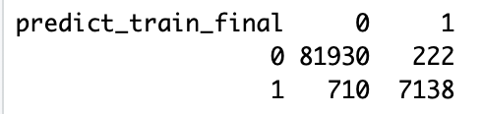
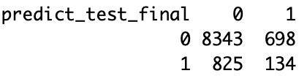
Procedure
Maxdepth = 30
Confusion matrix for training data
Confusion matrix for test data
Accuracy=(81930+7138)/90000=99.0%
True positive rate=
7138/(7138+710)=91%
True negative rate=
81930/(81930+222)=99.7%
Accuracy=(8343+134)/10000=84.8%
True positive rate=
134/(134+825)=14.0%
True negative rate=
8343/(8343+698)=92.3%
Notes:
But how to check the quality of the model.
Here we are using confusion matrix to examine observations.
There are three significant values in confusion matrix to evaluate the model.
They are ... ,
When the production that corresponds too closely to a particular set of data, and may therefore fail to fit additional data or predict future observations , its overfitting.

Slide 20
Procedure
Maxdepth = 30
Confusion matrix for training data
Confusion matrix for test data
Overfitting !!!
Accuracy=(81930+7138)/90000=99.0%
True positive rate=
7138/(7138+710)=91%
True negative rate=
81930/(81930+222)=99.7%
Accuracy=(8343+134)/10000=84.8%
True positive rate=
134/(134+825)=14%
True negative rate=
8343/(8343+698)=92.3%

Slide 21
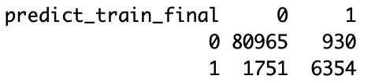

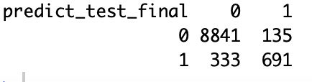

Procedure
Maxdepth = 21
Confusion matrix for training data
Confusion matrix for test data
Accuracy=(80965+6354)/90000=97.0%
True positive rate=
6354/(6354+1751)=78.4%
True negative rate=
80965/(80965+930)=98.9%
Accuracy=(8841+691)/10000=95.3%
True positive rate=
6754/(6754+2423)=67.5%
True negative rate=
8841/(8841+135)=98.5%
Notes:
After We have tried several numbers from 10 to 40, finally we find 21 is the best because three values are all good for training data and test data including true negative rate.

Slide 22
Random Forest

Slide 23
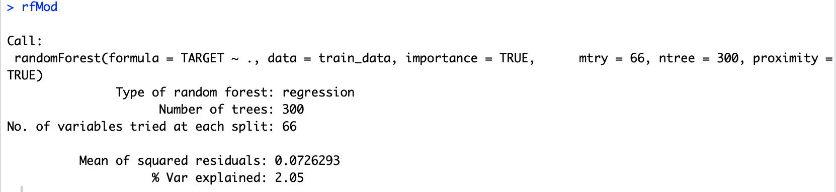
Random Forest
Build the model
Notes:
#RANDOM FOREST#We now apply random forests to the train_data dataset. #By default randomForest() uses 206/3 (cause we have 206columns)variables ,so we have mtry equalst to 66
also, after test, ntree is tend to be stable when its 100. Just as we can see the picture. after building model, now we make prediction for the test data

Slide 24
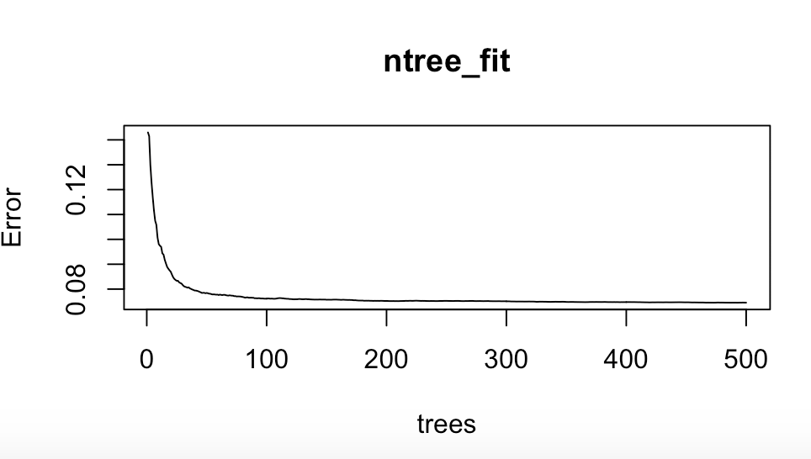
Random Forest
Optimize ‘ntree’
Use tuneRF() function to optimize ‘mtry’
Notes:
#RANDOM FOREST#We now apply random forests to the train_data dataset. #By default randomForest() uses 206/3 (cause we have 206columns)variables ,so we have mtry equalst to 66
also, after test, ntree is tend to be stable when its 100. Just as we can see the picture. after building model, now we make prediction for the test data

Slide 25
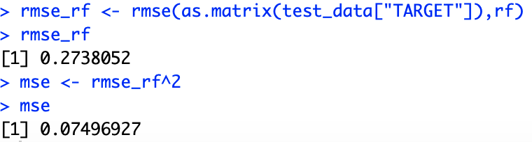

Random Forest
Make prediction
Compute RMSE and MSE
Plot important attributes
Notes:
●to compute RMSE and MSE
●actually I install a package called metrics which can compute rmse and mse easily

Slide 26
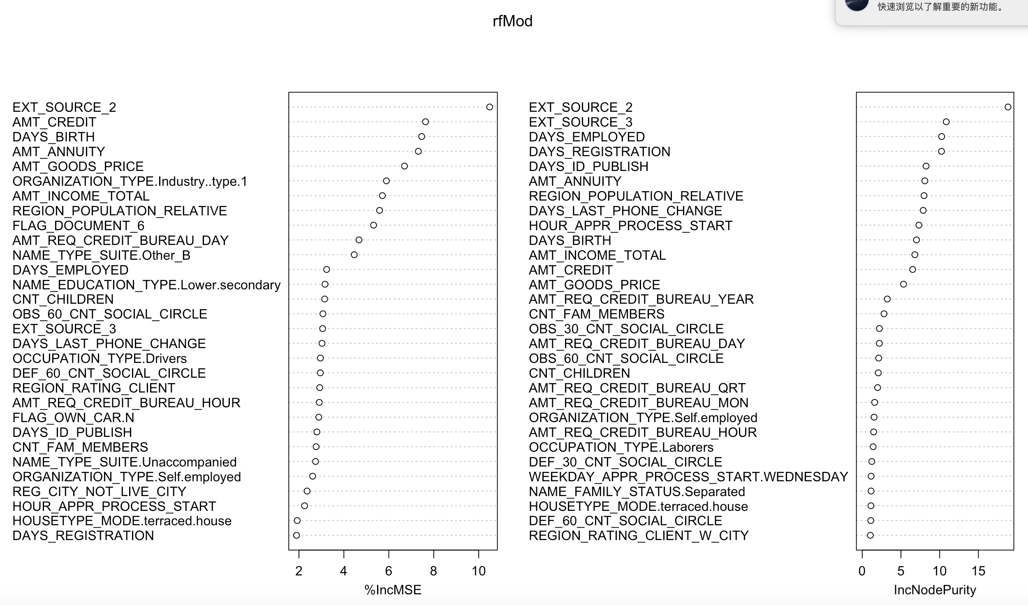
Attributes importance
The two metrics are the increase in MSE and increase in node purity by including the variable.
Node impurity is measured by training RSS for regression trees.
Notes:
●#The two metrics are the increase in MSE and increase in node purity by including the variable.#Node impurity is measured by training RSS for regression trees,

Slide 27
XGBoost

Slide 28
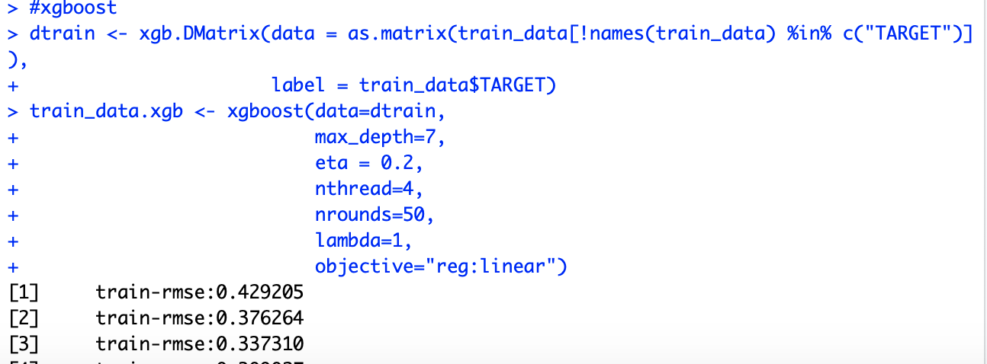
XGBoost
Build the model
Make prediction
Notes:
#We now try xgboost on the above dataset. In this xgboost model, we found when objective is linear, the mse is less than the mse when objective is logistic.
Here is explanation of each parameters in this model:
Maximum depth of a tree. Increasing this value will make the model more complex and more likely to overfit.
eta shrinks the feature weights to make the boosting process more conservative.
nthread [default to maximum number of threads available if not set] :Number of parallel threads used to run XGBoost

Slide 29
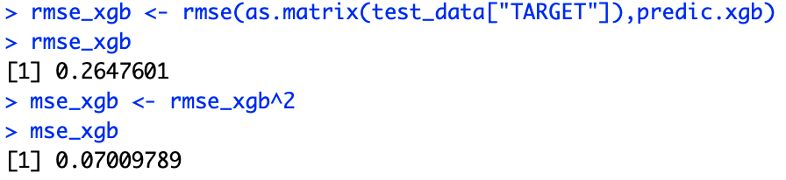
XGBoost
Compute MSE
Plot important attributes
Notes:
Then, we do the computation of rmse and mse just like what we have done in random forest. And polt the picture of top 10 important attributes.

Slide 30
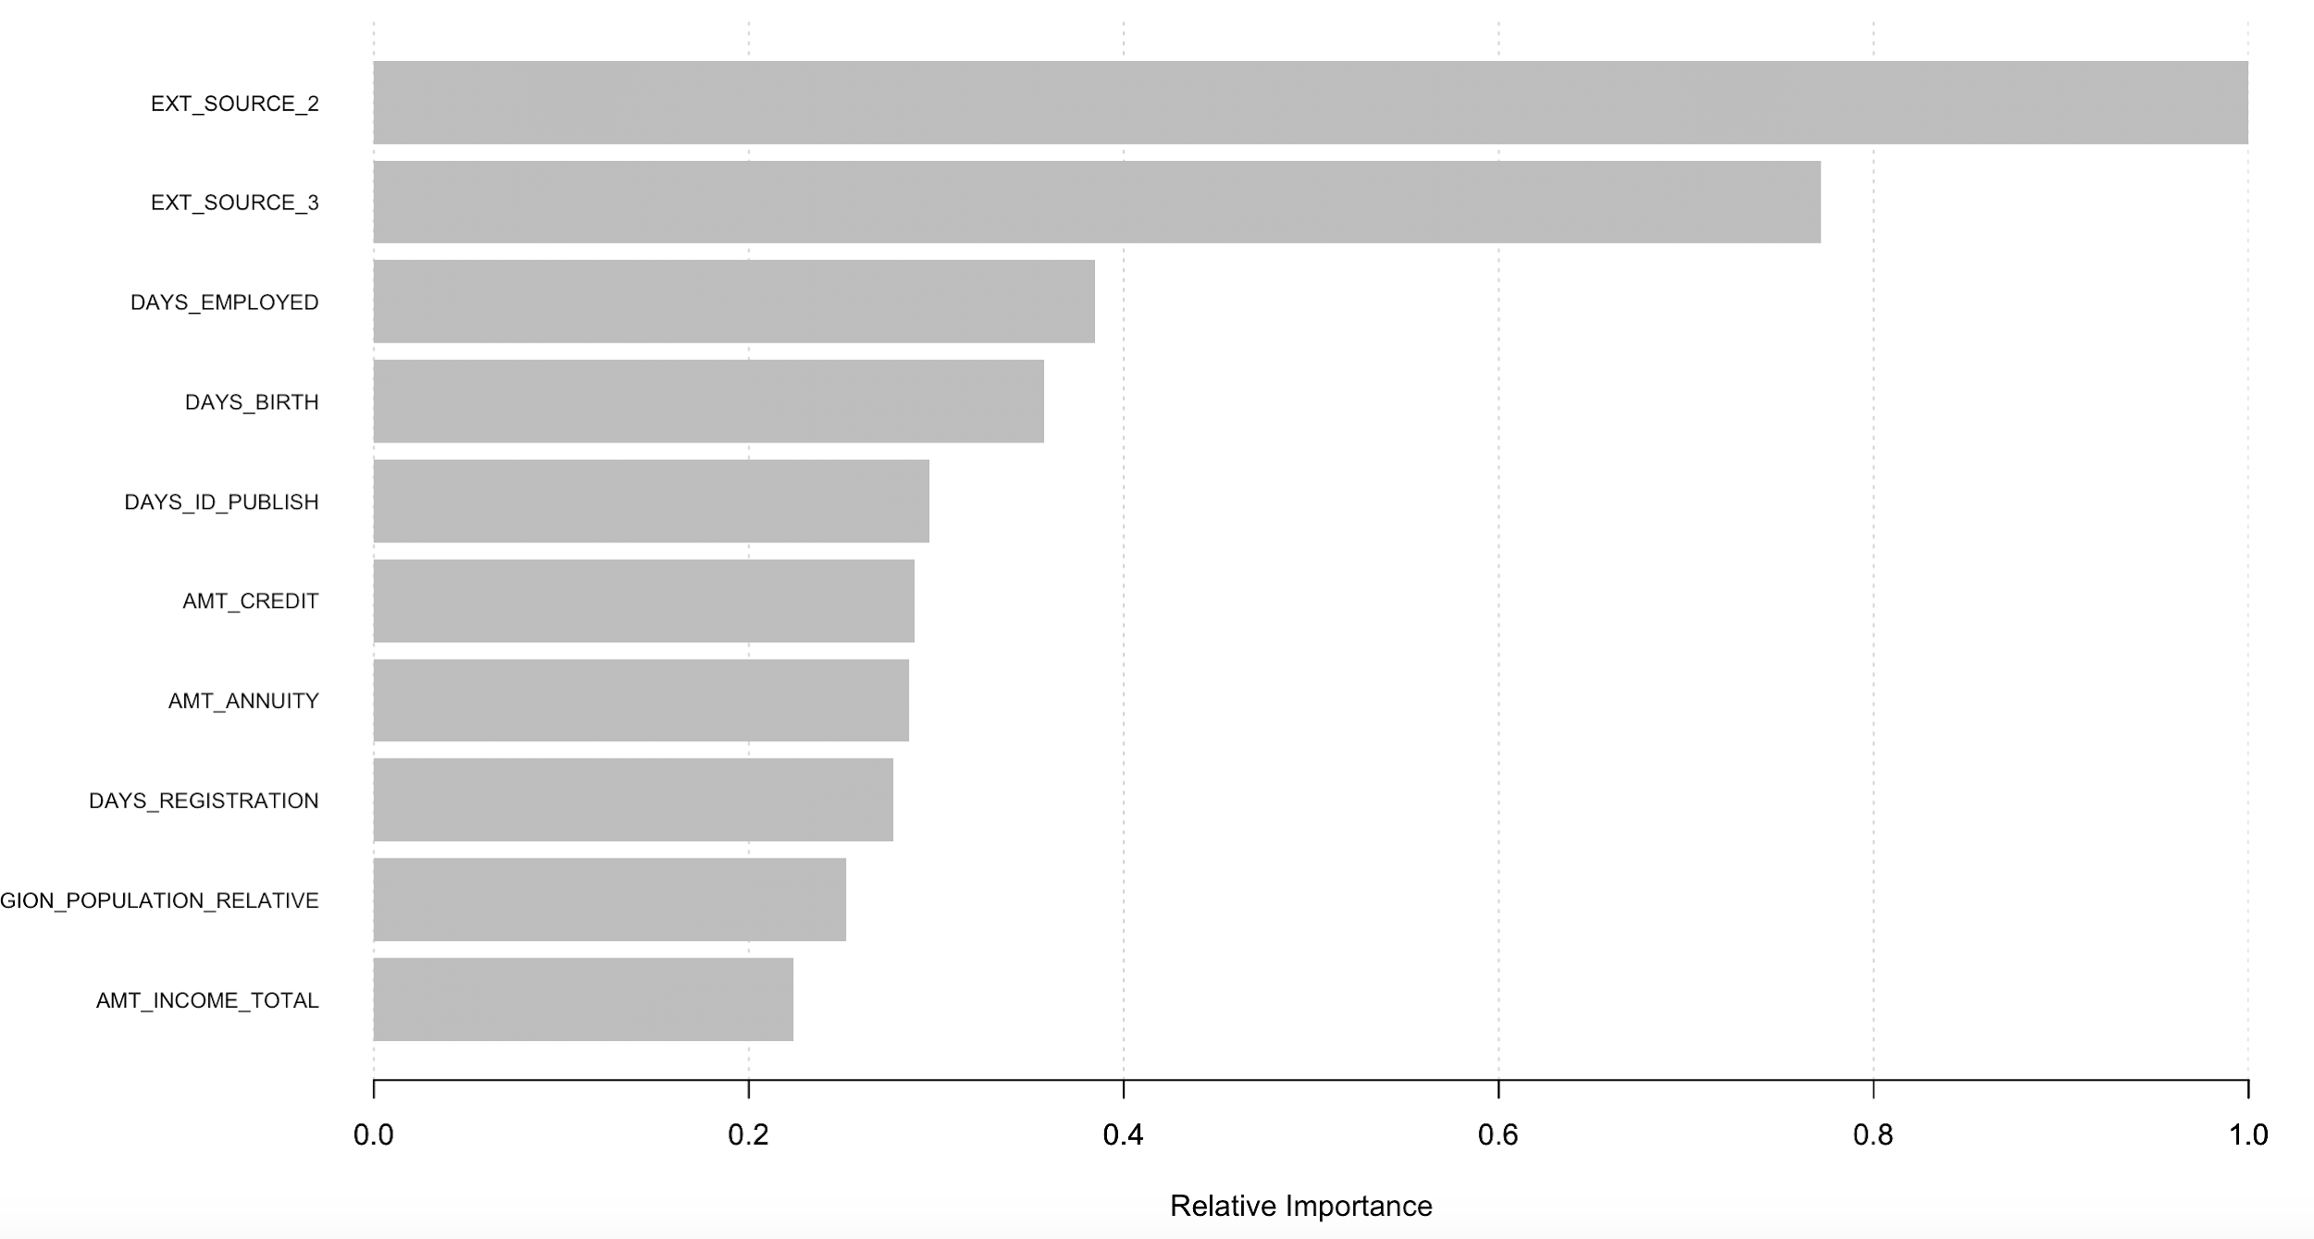
The top 10 important attributes
Notes:
Here is the top 10 important attributes, we can see that ...is the most important attributes.

Slide 31


Model | RMSE
Linear Regression | 0.06797
Decision Tree | 0.066
Random Forest | 0.07313069
XGBoost | 0.06953182

Slide 32
Conclusion & future direction
According the comparison of different model, EXT_SOURCE_2, EXT_SOURCE_3, DAYS_EMPLOYED, ATM_CREDIT, ATM_ANNUITY are important features
XGBoostis a better model with less MSE and faster performance
In the future
Make the input data as the same size
Combine other tables to check other probabilities

